Slide 1




Wireshark & Fiddler Tips & Tricks

Slide 2

What are these two tools used for?
Wireshark
Fiddler
F
Live capture and offline analysis
Deep inspection of hundreds of protocols
Standard three-pane packet browser
Multi-platform
The most powerful display filters in the industry
Rich VoIP analysis
Read/write many different capture file formats
Decryption support for many protocols, including: IPsec, ISAKMP, Kerberos, SNMPv3, SSL/TLS, WEP, and WPA/WPA2
Coloring rules
Output can be exported
Web Session Manipulation
Performance Testing
Security Testing
HTTP/HTTPS Traffic Recording
Web Debugging

Slide 3

Wireshark What is it?
Wireshark is an open-source packet analysis suite.
I use it for network troubleshooting, and “debugging” any software that use a network to communicate.
You can even monitor traffic over a Bluetooth interface, or USB.
Based around libpcap, a packet capture library.

Slide 4



WiresharkEthereal
The first time I used Wireshark was in the summer of 2001, it was called Ethereal.
I took home (with permission) a server from high school that nobody had the password to, It used to be an internet gateway.
The IP address taped to it was a lie.
Using Ethereal, I was able to find out what the IP address of this very chatty headless SGI Indy was.
Since it was IRIX, a readily available telnetd exploit politely gave me root access (https://www.securityfocus.com/bid/1572/info)
I am root

Slide 5
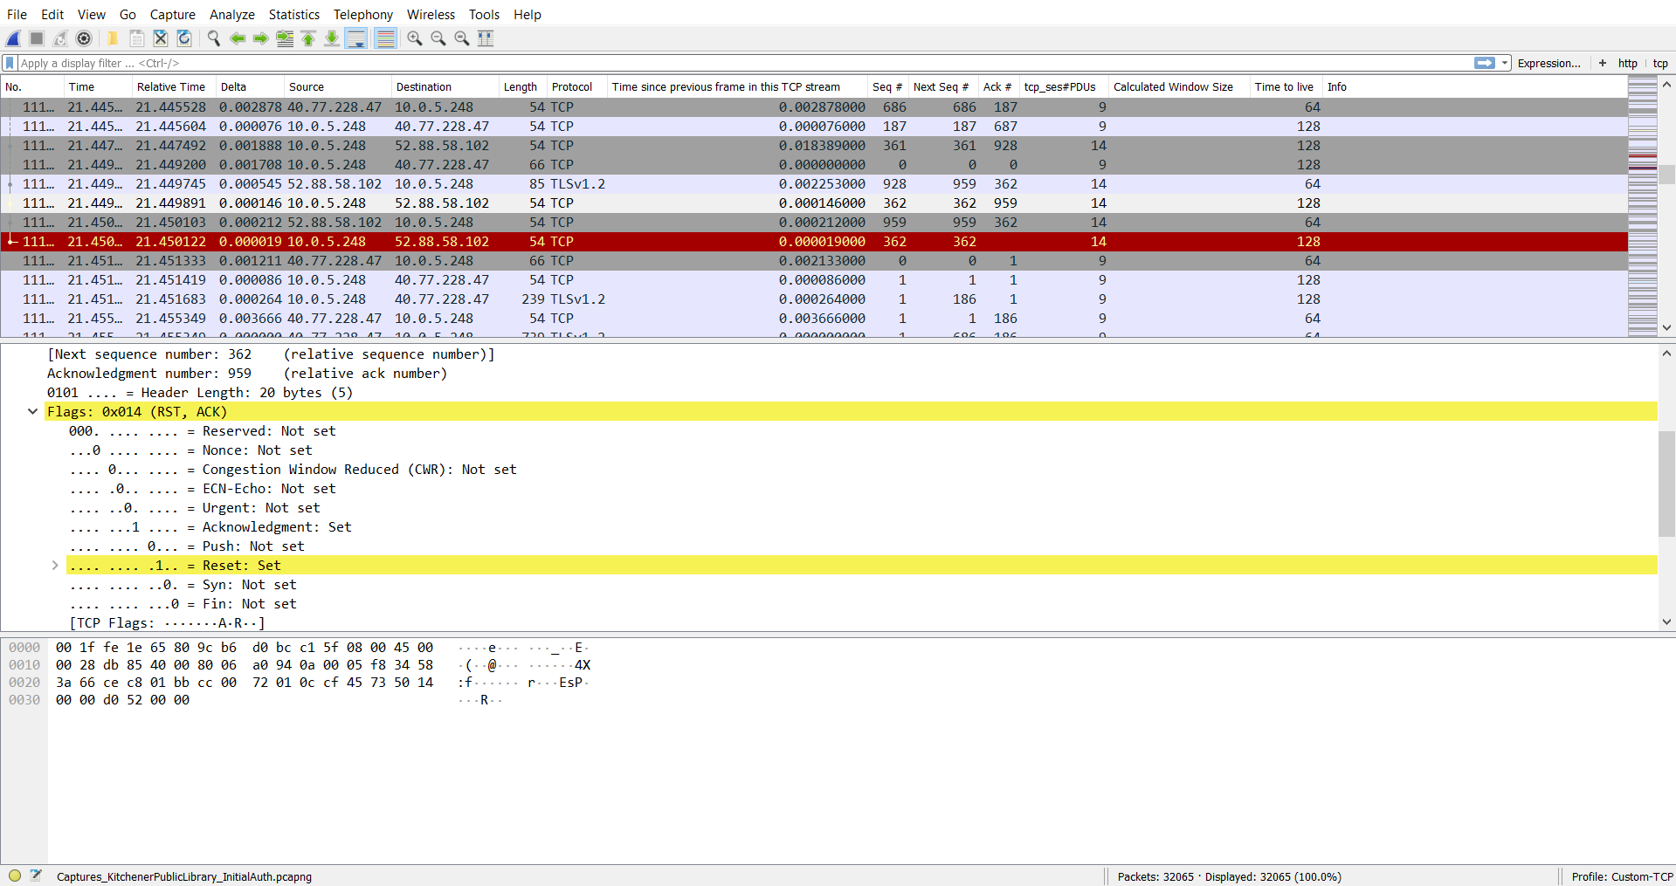
1) A Powerful Filter bar
What else can Wireshark do?
z

Slide 6

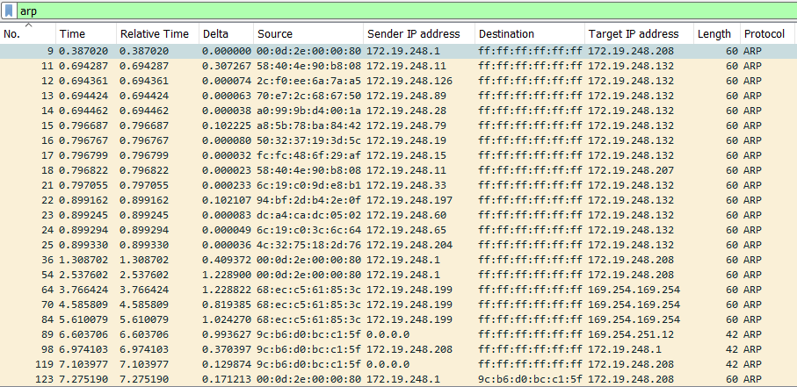
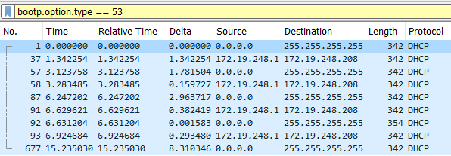
Wireshark A Sample Capture Filtering by protocol
1) A Powerful Filter Bar
To find my Indy today, I would have opened up Wireshark and filtered for arp traffic (as shown). I could get clever and search for any MAC address from the SGI block eth.addr contains 08:00:69
Alternatively, maybe look for any bootp.option.type == 53 (as shown) which is the DHCP Discover Message Type

Slide 7
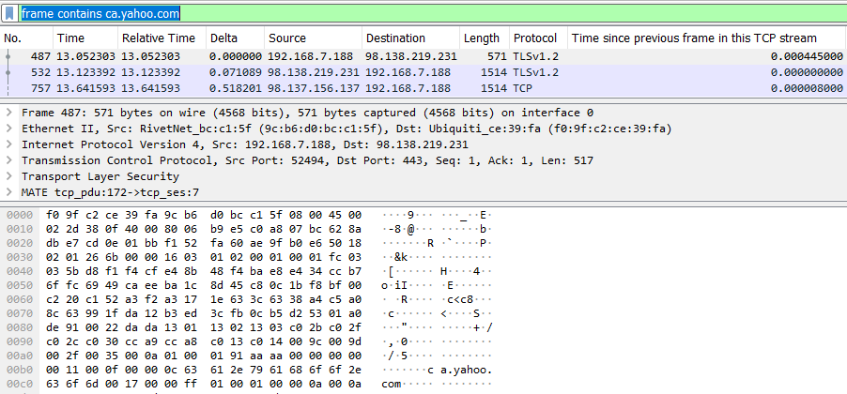
Wireshark A Sample Capture Searching for Text
If you are looking for a particular string, you can filter out packets by this filter:
frame contains text
Here’s an example of searching for packets that contain ca.yahoo.com

Slide 8
2) Configurable Columns
z

Slide 9
2) Configurable Columns
Configurable Columns My default TCP Profile

Slide 10
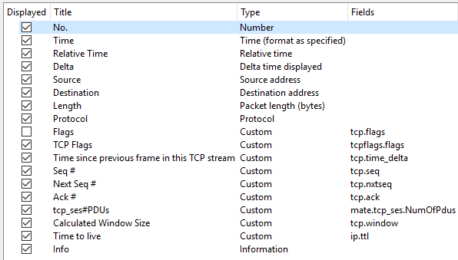
Wireshark Configurable Columns My default TCP Profile
Most of these columns are self explanatory.
Sometimes there is more information presented than is needed.

Slide 11
3) Color Coded Highlights
z

Slide 12
Wireshark Color Coded Highlights
3) Color Coded Highlights
There are 4 colors here, red being the one that sticks out.

Slide 13
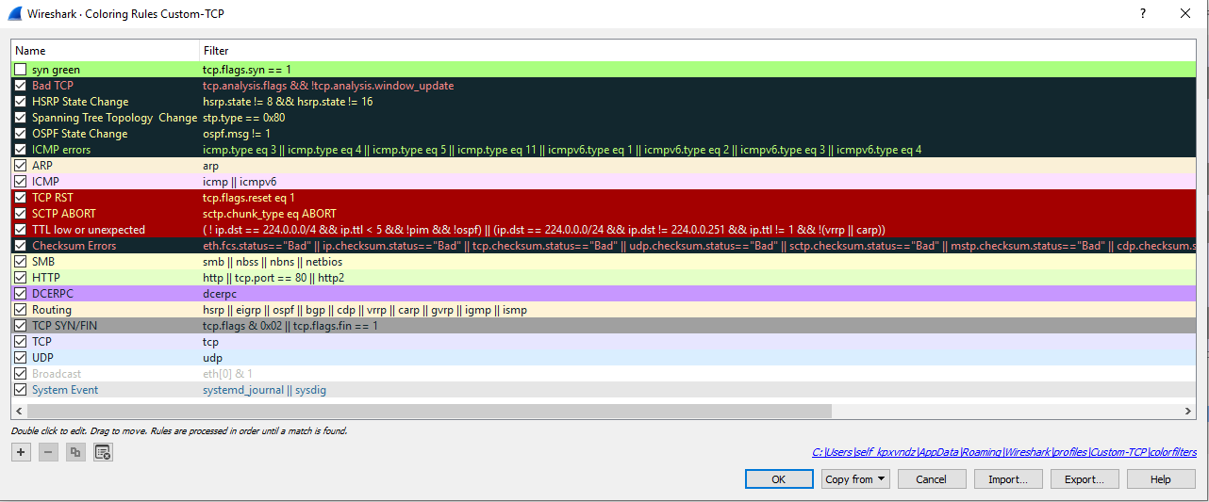
Wireshark Color Coded Highlights
Wireshark's Coloring Rules (View > Coloring Rules) allow you to have control how you see things.
These are the default rules, except for the top one “syn green” which I picked up from a Wireshark Conference video I watched online.
I rarely change these.

Slide 14
4) Details about Packets
z

Slide 15
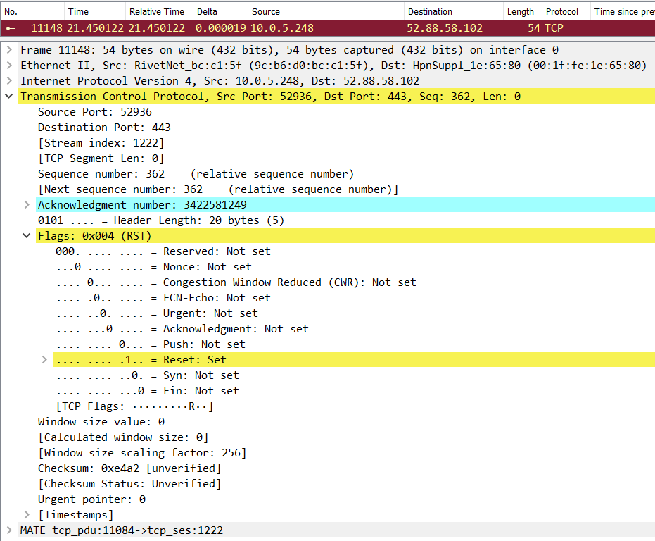
Wireshark Details about Packets Red may not mean bad.
Red is telling us that a TCP Reset has occurred.
We can filter on this conversation to find out more.
4) Details about Packets

Slide 16
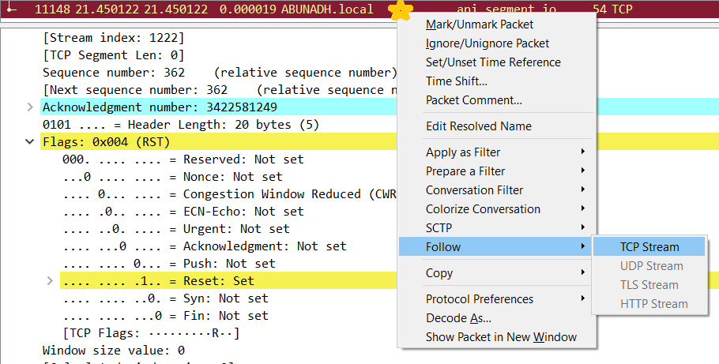
Wireshark Details about Packets Red may not mean bad.
Right click on the session that we want to focus on
Go to “Follow” > “TCP Stream”

Slide 17
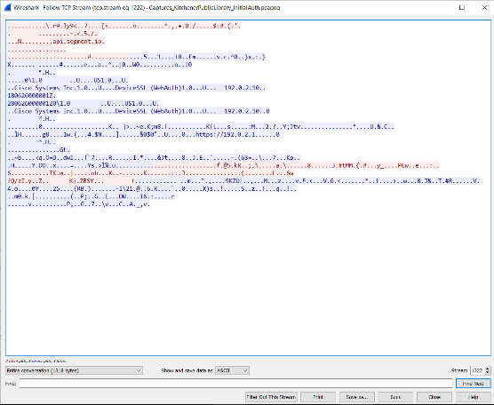
Wireshark Details about Packets Red may not mean bad.
The conversation between the two hosts is shown.
Red is the local computer (client)
Blue is the remote computer (server)

Slide 18
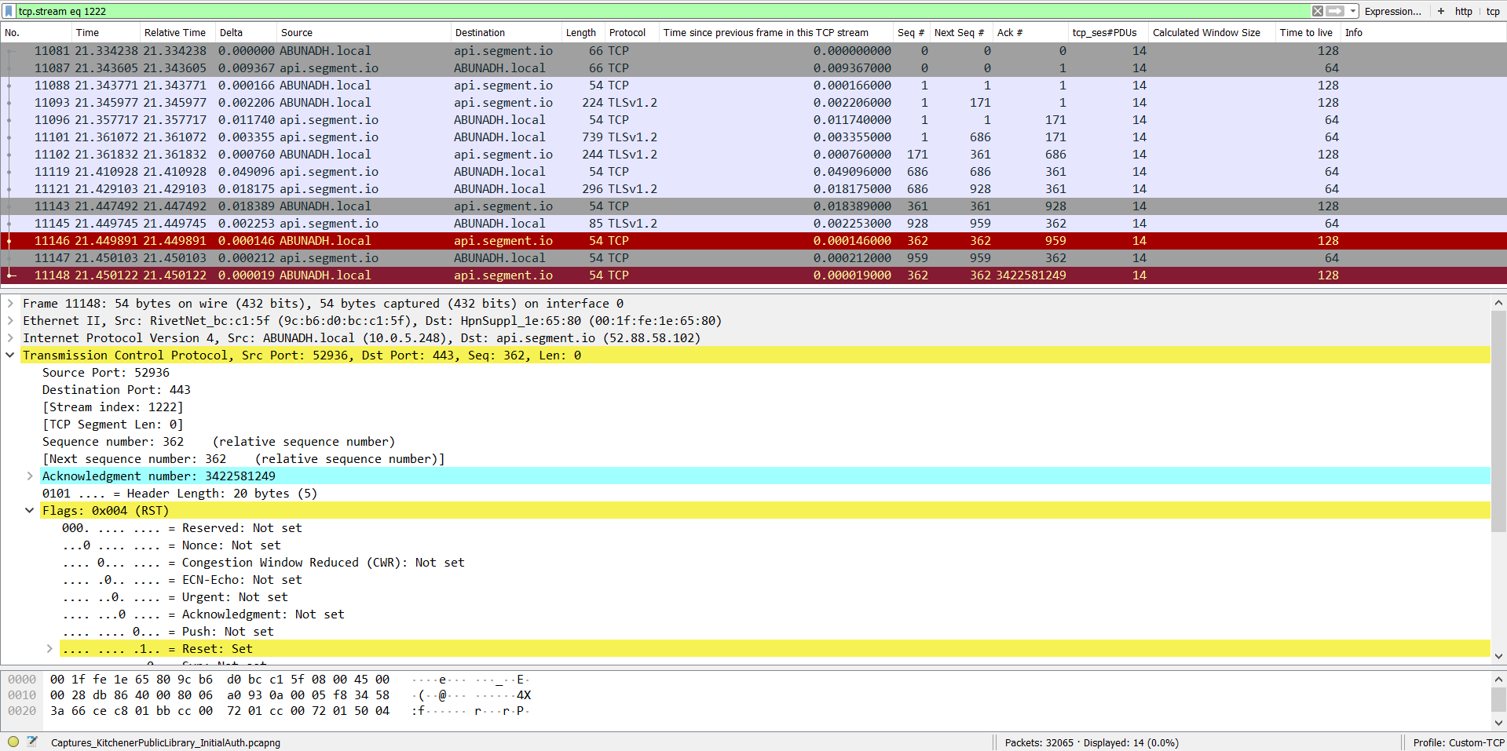
Wireshark Details about Packets Red may not mean bad.
The conversation between the two hosts is shown.
The Stream is “1222”
The TCP Flag’s show Reset, what are the other packets saying?

Slide 19
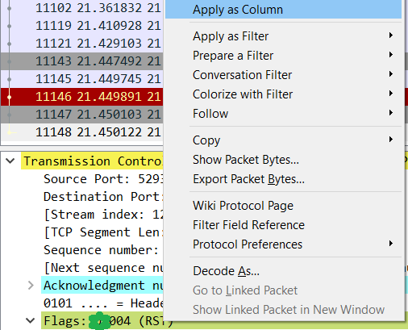
Wireshark Details about Packets Red may not mean bad.
z
Right click on “Flags” and then “Apply as Column”

Slide 20
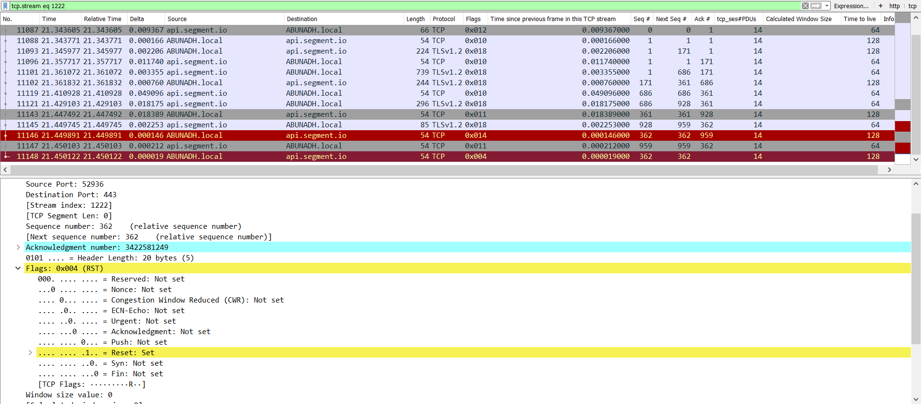
Wireshark Details about Packets Red may not mean bad.
z
Now we can see the Flags of each connection, but I’m horrible at reading hex bitmasks.
Let’s add a custom LUA filter by following the instructions from this blog: https://blog.didierstevens.com/2014/04/28/tcp-flags-for-wireshark/

Slide 21
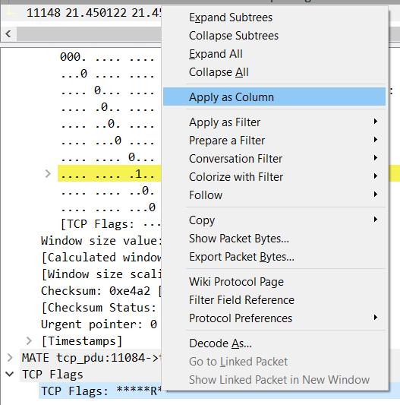
Wireshark Details about Packets Red may not mean bad.
Download http://didierstevens.com/files/software/wireshark-lua-dissectors_V0_0_3.zip
In the zip file, Copy: tcp-flags-dissector.lua To C:\Program Files\Wireshark\plugins
Restart Wireshark
Filter for: tcp.stream eq 1222
In the Packet Details window, we now see “TCP Flags”.
Right click on it, and “Apply as Column”

Slide 22
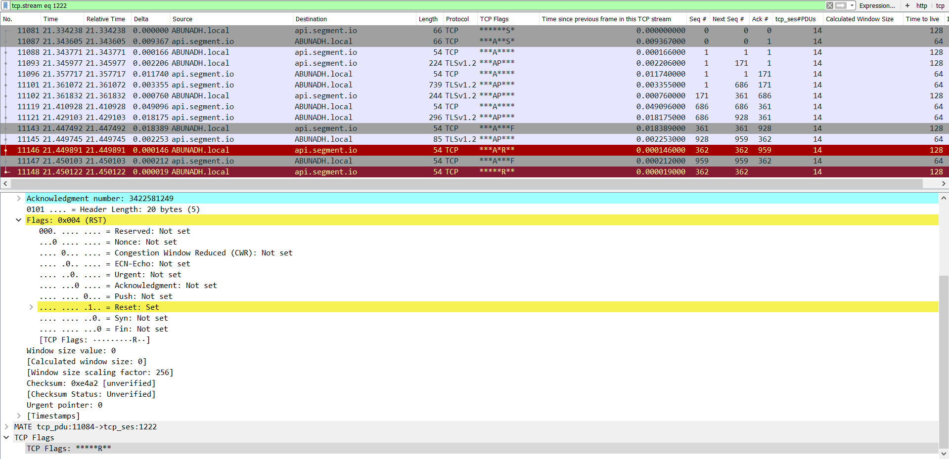
Wireshark Details about Packets Red may not mean bad.
z
A “SNORT” style TCP Flag list. Lovely!
My working knowledge of TCP is limited, but I think this looks like the client negotiating an anticipated disconnect, and the packets are slightly out of order.
A*R = Client is Acknowledging the packet, and sending a Reset.
*R* = Reset

Slide 23
Wireshark Details about Packets Red may not mean bad.
MATE
The Meta Analysis and Tracing Engine (MATE) is my go to extension to configure on a new Wireshark install. You’ll see it in screen shots and I’ll casually refer to it.
Examples taken from: https://wiki.wireshark.org/Mate/Examples
Cloudshark Link: http://cloudshark.org/captures/9279c75f8161
MATE groups everything in Protocol Data Units (PDUs), a PDU is a specific block of information transferred over a network. https://techterms.com/definition/pdu
Sessions that last less longer than one second
mate.tcp_ses.Time > 1
This is great for narrowing down any type of sessions which don't last long. If you are looking for timeouts or other types of issues, this will be valuable.
Tcp sessions that have less than 5 packets.
mate.tcp_ses.NumOfPdus < 5

Slide 24
Wireshark Details about Packets Red may not mean bad.
MATE
A TCP session has a triple handshake, and usually at least a few exchanges after that. So if we search for sessions with less than 5 Packets, chances are it's an unreachable connection or something that's blocked off.
Packets for the third tcp session MATE has found This is the (Stream Index - 1):
mate.tcp_ses == 1
Show all unsuccessful TCP connection attempt retries (from the MATE documentation):
https://osqa-ask.wireshark.org/questions/10640/how-to-find-syn-not-followed-by-a-synack/10758
(mate.tcp_ses.NumOfPdus < 4) && (tcp.flags eq 0x02 && tcp.analysis.retransmission)
This filter adds to the previous ones, we look for any retries, and specifically packets that are less than 4. If we make this greater than 4, we can actually find packet loss in a particular connection.

Slide 25
Wireshark Details about Packets Red may not mean bad.
Transform rm_client_from_http_resp1 {
Match (http_rq);
Match Every (addr) Insert (not_rq);
};
Transform rm_client_from_http_resp2 {
Match (not_rq, client) Replace ();
};
Pdu http_pdu Proto http Transport tcp/ip {
Extract addr From ip.addr;
Extract port From tcp.port;
Extract http_rq From http.request.method;
Extract http_rs From http.response;
Extract host From http.host;
Extract client From ip.src;
Transform rm_client_from_http_resp1, rm_client_from_http_resp2;
DiscardPduData true;
};
Gop http_req On http_pdu Match (addr, addr, port, port) {
Start (http_rq);
Stop (http_rs);
Extra (host, client);
};
Gog http_use {
Member http_req (host, client);
Member dns_req (host, client);
Expiration 0.75;
};
Done;
Pdu tcp_pdu Proto tcp Transport ip {
Extract addr From ip.addr;
Extract port From tcp.port;
Extract tcp_start From tcp.flags.syn;
Extract tcp_stop From tcp.flags.reset;
Extract tcp_stop From tcp.flags.fin;
};
Gop tcp_ses On tcp_pdu Match (addr, addr, port, port) {
Start (tcp_start=1);
Stop (tcp_stop=1);
};
Pdu ping_pdu Proto icmp Transport ip {
Extract addr From ip.addr;
Extract icmp_type From icmp.type;
Extract icmp_seq From icmp.seq;
};
Gop ping_pair On ping_pdu Match (addr, addr, icmp_seq) {
Start (icmp_type=8);
Stop (icmp_type=0);
};
Transform rm_client_from_dns_resp {
Match (dns_resp=1, client) Replace (dns_resp=1);
};
Pdu dns_pdu Proto dns Transport ip {
Extract addr From ip.addr;
Extract dns_id From dns.id;
Extract dns_resp From dns.flags.response;
Extract host From dns.qry.name;
Extract client From ip.src;
Transform rm_client_from_dns_resp;
};
Gop dns_req On dns_pdu Match (addr,addr,dns_id) {
Start (dns_resp=0);
Stop (dns_resp=1);
Extra (host, client);
};
Edit > Preferences > Protocols > MATE
Add the path to a MATE file, you can download one from the MATE manual:
https://wiki.wireshark.org/Mate/Examples

Slide 26
5) Actual Packet Bytes
z

Slide 27
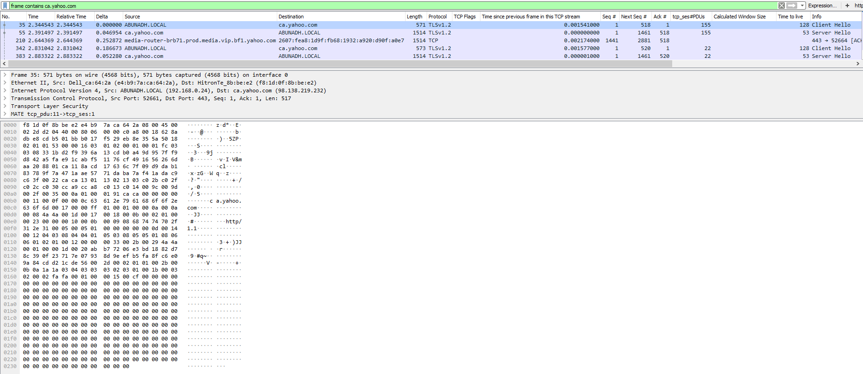
Wireshark HTTPS Decryption on the Client (Firefox/Chrome/libcurl)
5) Actual Packet Bytes
This traffic is encrypted, and HTTPS decryption used to be a lot easier when we could just have the ssl certificates.
Use of the ephemeral Diffie-Hellman (DHE) cipher suite means that the secrets are no longer transferred on the wire.
Setting an environmental variable to capture the shared secrets from the browser/supported apps is generally the solution:
SET SSLKEYLOGFILE=%USERPROFILE%\sslkeysENV.pms
Disable HTTP2 support for a better experience:
“path\to\chrome.exe" --disable-http2
Add a host entry for the site that you’ll be looking at traffic for, it makes things easier (be wary, it may hide issues):
98.138.219.232 ca.yahoo.com
Other methods are documented on the Wireshark manual: https://wiki.wireshark.org/SSL

Slide 28
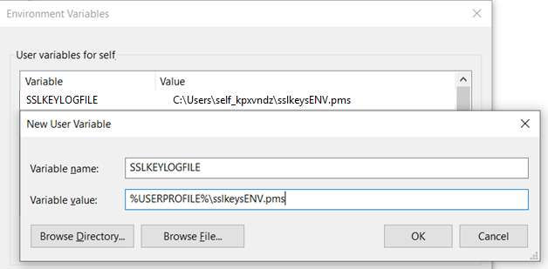
Wireshark HTTPS Decryption on the Client (Firefox/Chrome/libcurl)
Setting the Global User Variable
With this setting, all programs that support SSLKEYLOGFILE will write to this file.
SET SSLKEYLOGFILE=%USERPROFILE%\sslkeysENV.pms
When you want to capture Data
Always open Wireshark and Start the Capture First
You will want to restart any application that is open before starting to capture as well.

Slide 29
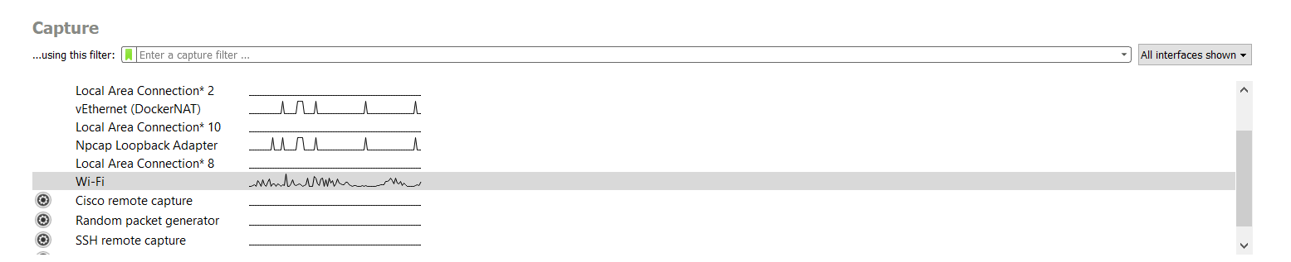
Capturing HTTPS Data
Start a Wireshark Capture by double clicking on your interface
Open up Chrome with HTTP2 disabled, and visit https://ca.yahoo.com/
C:\Users\self_kpxvndz> "C:\Program Files (x86)\Google\Chrome\Application\chrome.exe" --disable-http2 https://ca.yahoo.com

Slide 30
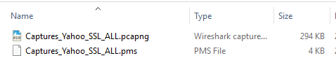
Capturing HTTPS Data
Once the Webpage has Loaded, Quit Chrome
Stop the Wireshark Capture
In Wireshark, goto File> Save As, and save the capture to that folder, ie: C:\Media\Meetups\WireSharkFiddler\Captures\Captures_Yahoo_SSL\
Copy the sslkeysENV.pms file from your users directory to this folder as well. I usually keep the same base name.

Slide 31
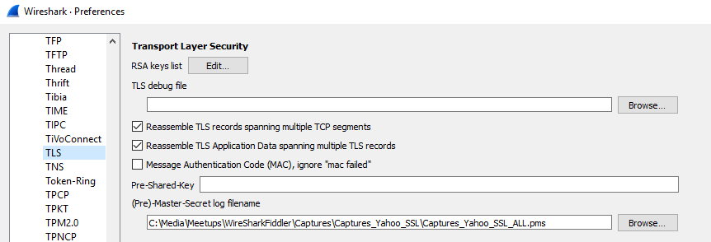
Wireshark HTTPS Decryption on the Client (Firefox/Chrome/libcurl)
I setup my (Pre)-Master-Secret log filename on an as needed basis. I rarely attach Wireshark directly to the one that I am having other applications write to.
I want to always have a copy of the Shared Secrets file stored with my capture.
In the Wireshark Preferences (Edit > Preferences > Protocols > TLS) I’ve configured this path to match the path from the previous slide.

Slide 32
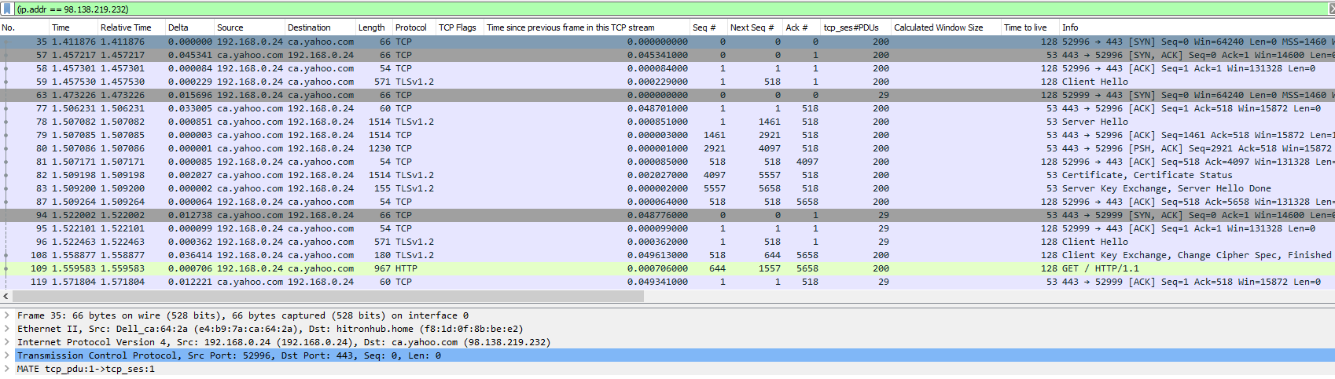
Wireshark HTTPS Decryption on the Client (Firefox/Chrome/libcurl)
Filter on (ip.addr == 98.138.219.232) (the host entry we added to make things easier)
You can see that there is a
Client Hello
Server Hello
Key Exchange
And a GET / HTTP/1.1
Let’s export this file.

Slide 33
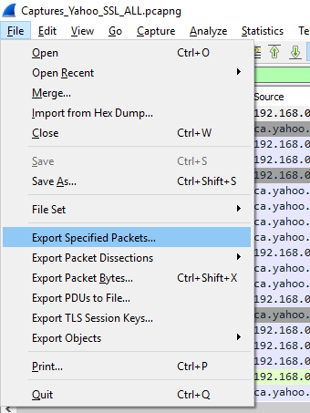
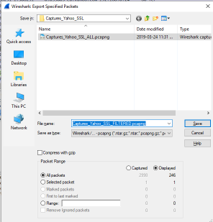
Wireshark HTTPS Decryption on the Client (Firefox/Chrome/libcurl)
File > Export Specified Packets…
File Name: Captures_Yahoo_SSL_FILTERED.pcapng
Displayed
All Packets
Since this filter contains the key exchange, we’ll be able to decrypt the contents.

Slide 34
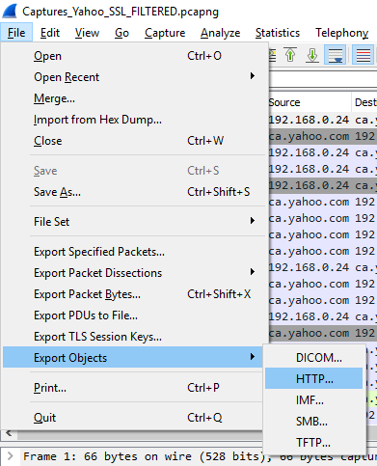
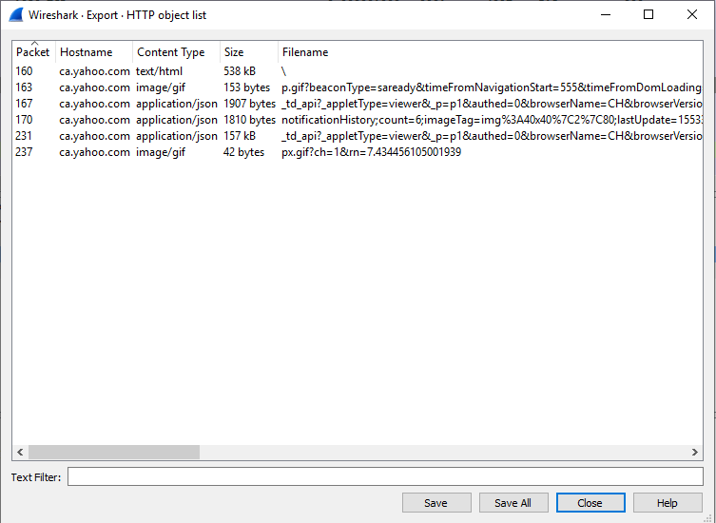
Wireshark HTTPS Decryption on the Client (Firefox/Chrome/libcurl)
Open the Captures_Yahoo_SSL_FILTERED.pcapng Capture file
Let’s see what HTTP Objects are available:
File > Export Objects > HTTP…
There are 6 objects from ca.yahoo.com!
You can save these, but they’ll usually have invalid characters in them, so one by one is best.
If you’re curious about extracting resources in bulk, there’s a great write up here:
https://www.giac.org/paper/gcia/9206/extracting-files-network-packet-captures/123856

Slide 35
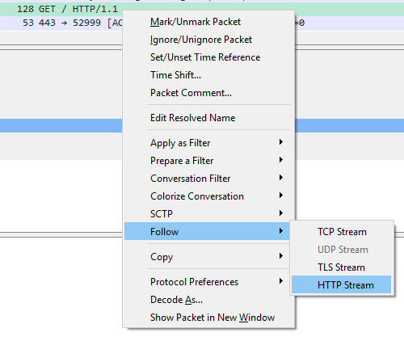
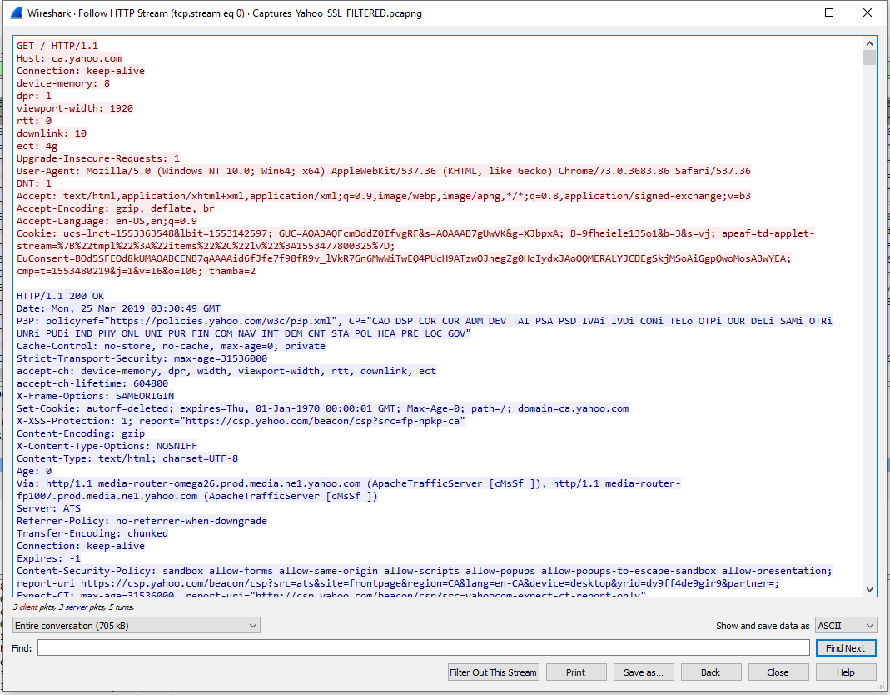
Wireshark HTTPS Decryption on the Client (Firefox/Chrome/libcurl)
Right click on the “GET / HTTP/1.1” entry, and select:
Follow > HTTP Stream
Now you can see the unencrypted text.

Slide 36
6) Status Window
z

Slide 37
6) Status Window
You can find out how many packets are captured, and the number/percent of how many your current display filter is showing.
Wow.

Slide 38
7) Easy Mode Button
z

Slide 39
Click this Stop Light button to bring up the Expert Information Window
7) Easy Mode Button

Slide 40
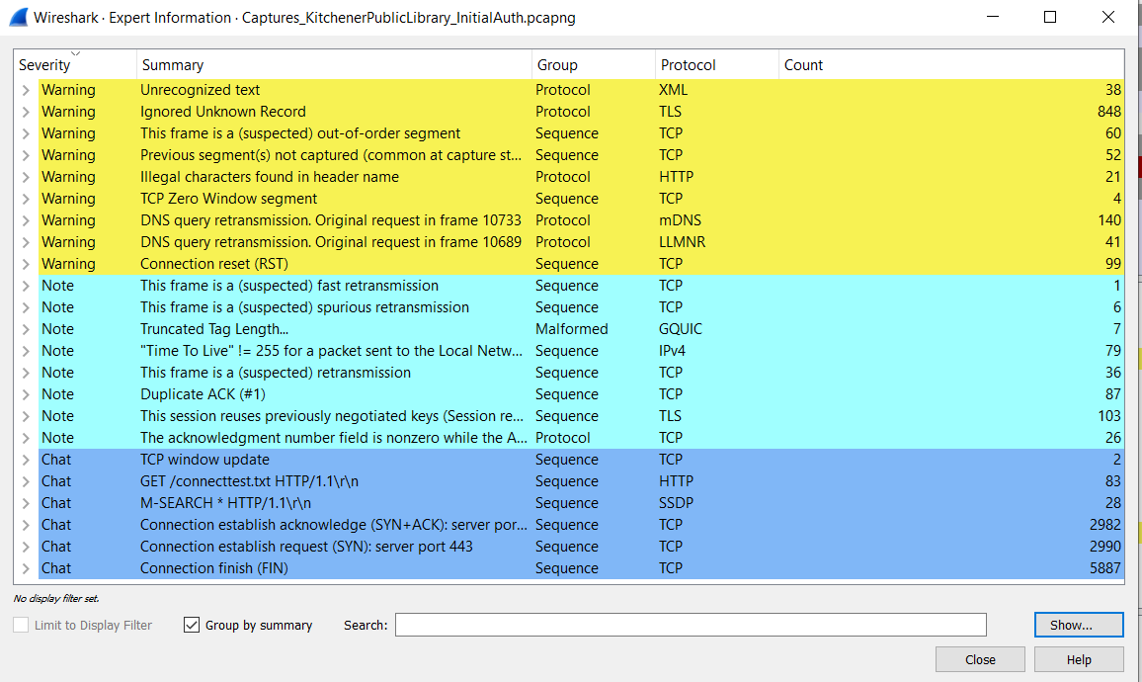
The Expert Information Window is the first place I go when looking in an unfamiliar network capture.
Using a Display Filter is incredibly handy, specially if you know one of the offending IP addresses

Slide 41
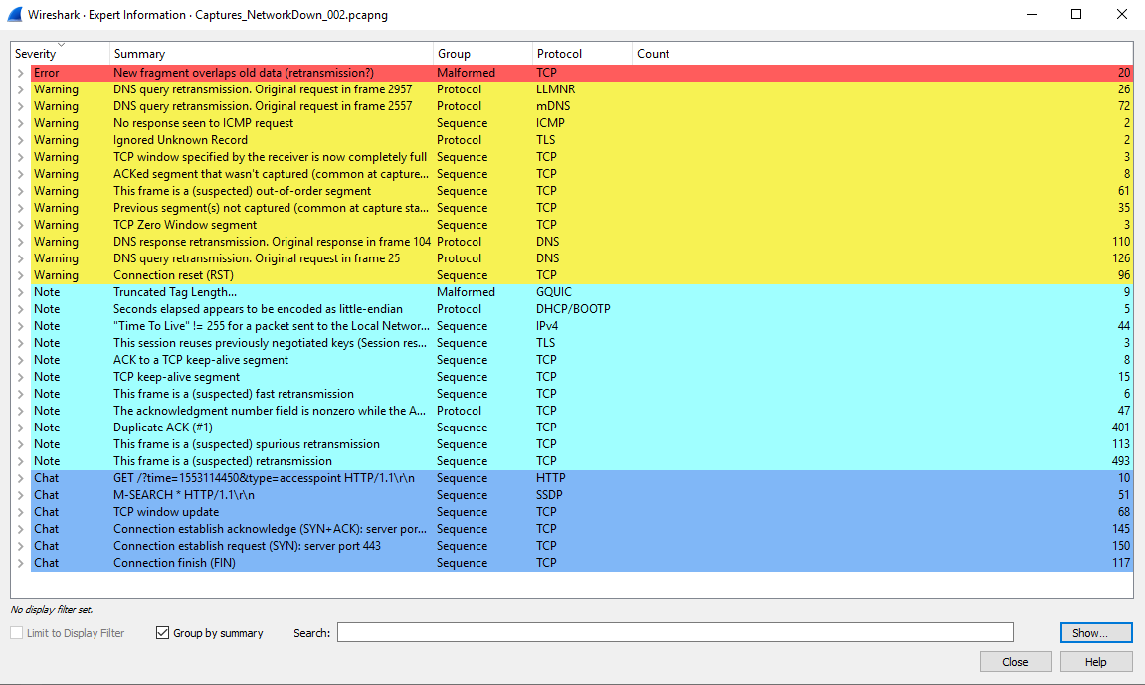
This Expert Information Window is from a really weak and saturated WiFi network.

Slide 42
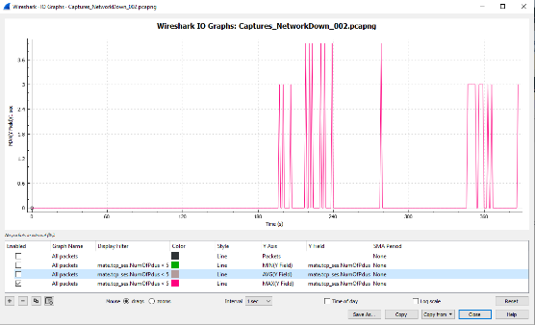
The IO Graph (Statistics > IO Graphs)
z
IO Graphs can be used to plot any field, and you can do aggregates on them.
This should show areas when there were failures to connect to a particular host, because almost all TCP network connections have more than 4 packets in their life type.

Slide 43
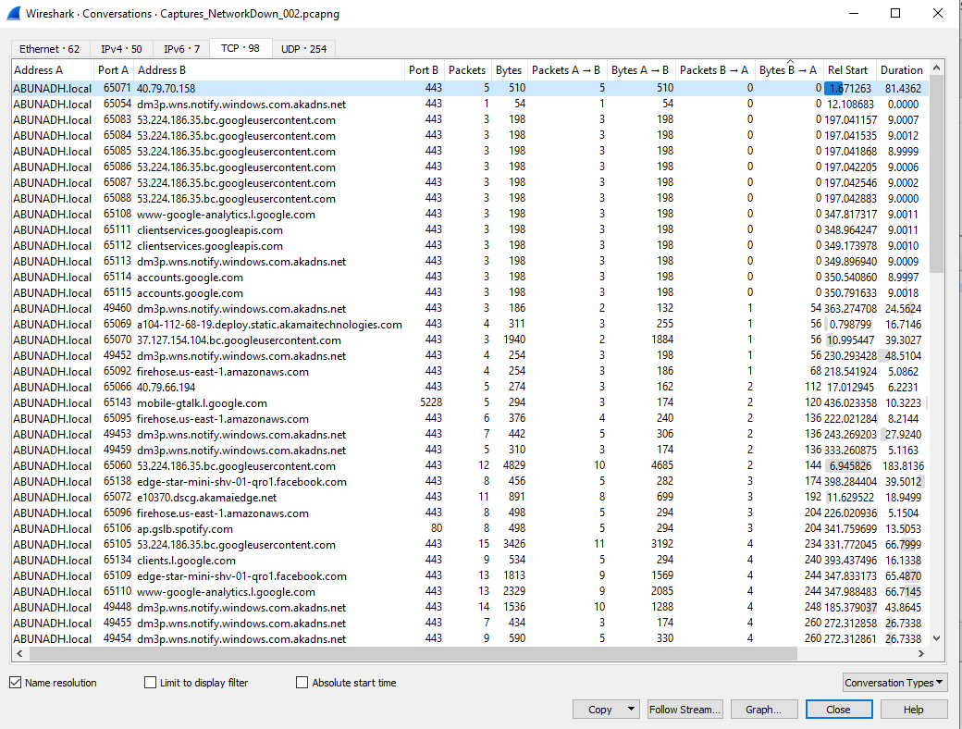
Conversations (Statistics > Conversations)
z
Any Conversations that have Bytes B -> A as Zero, generally means a connection was not able to be made.
This could be caused by a bad route, a firewall, or software (anti virus).

Slide 44
Wireshark Capturing Traffic on all ends
When examining a network issue, you generally want to capture traffic on as many endpoints as possible, such as:
Web Server
Proxy Server/Load Balancer
Client Application

Slide 45
Wireshark How to Man In The Middle (MITM) on the server?
Your Gateway may export decrypted traffic on both ends for you.
Are you using SSL/TLS between your server and the proxy? If you’re not, then capture at the web server level.
You can try forcing a particular insecure Cipher Suite by either Group Policy, or your platforms SSL configuration.
These are generally preferences, and the server may deny them.

Slide 46
Fiddler What is it?
Fiddler is a Free tool provided by Progress
I use it at least once every day.
It’s familiar, easy to navigate, and powerful.
The latest ports are cross platform with mono support.
It can also act as a man in the middle server
F

Slide 47
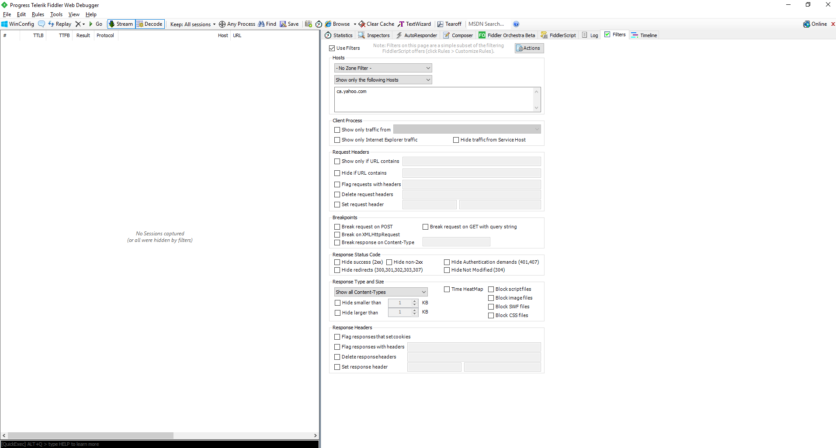
1) Easy HTTPS Decryption
z

Slide 48
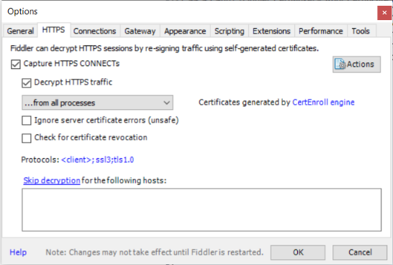
Fiddler Easy HTTPS Decryption
1) Easy HTTPS Decryption
You can easily decrypt traffic in fiddler by just going to:
Tools > Options > HTTPS
Click “Decrypt HTTPS traffic”
Subsequently click Yes/Agree/Ok/Alright to every window that pops up.
You are now able to decrypt the majority of HTTPs traffic from anything that is WININET PROXY aware.

Slide 49
2) A Powerful Filter Tab
z

Slide 50
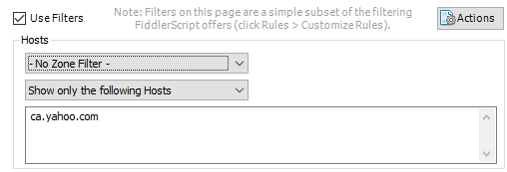
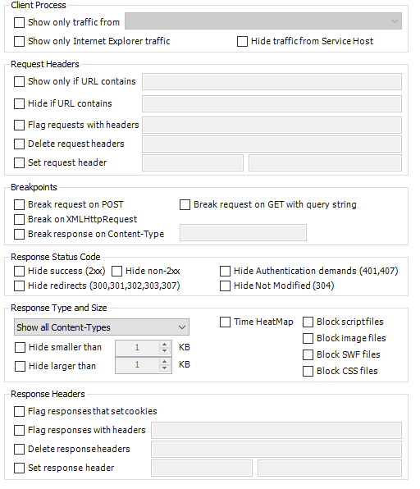
Fiddler Filter Options
2) A Powerful Filter Tab
Fiddler can filter by certain hosts, and in this example I’ll be using ca.yahoo.com
We can also filter on Request Headers, certain processes, and also enable breakpoints (for tampering)

Slide 51
3) Remote Connections
z

Slide 52
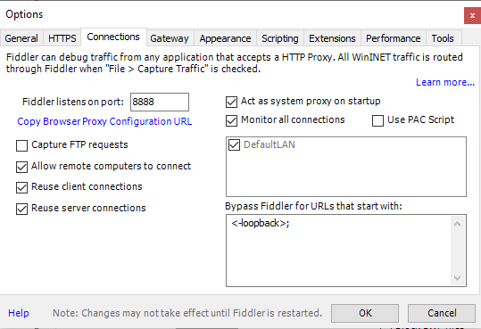
Fiddler Remote Connections
3) Remote Connections
You can direct traffic from remote sources (android/iphone, remote web applications/java applications, other computers)
Enable “Allow remote computers to connect”
Warning: This will allow remote computers to connect to your computer and use it as a proxy.
To set this up, use the Computers IP address, and port 8888

Slide 53
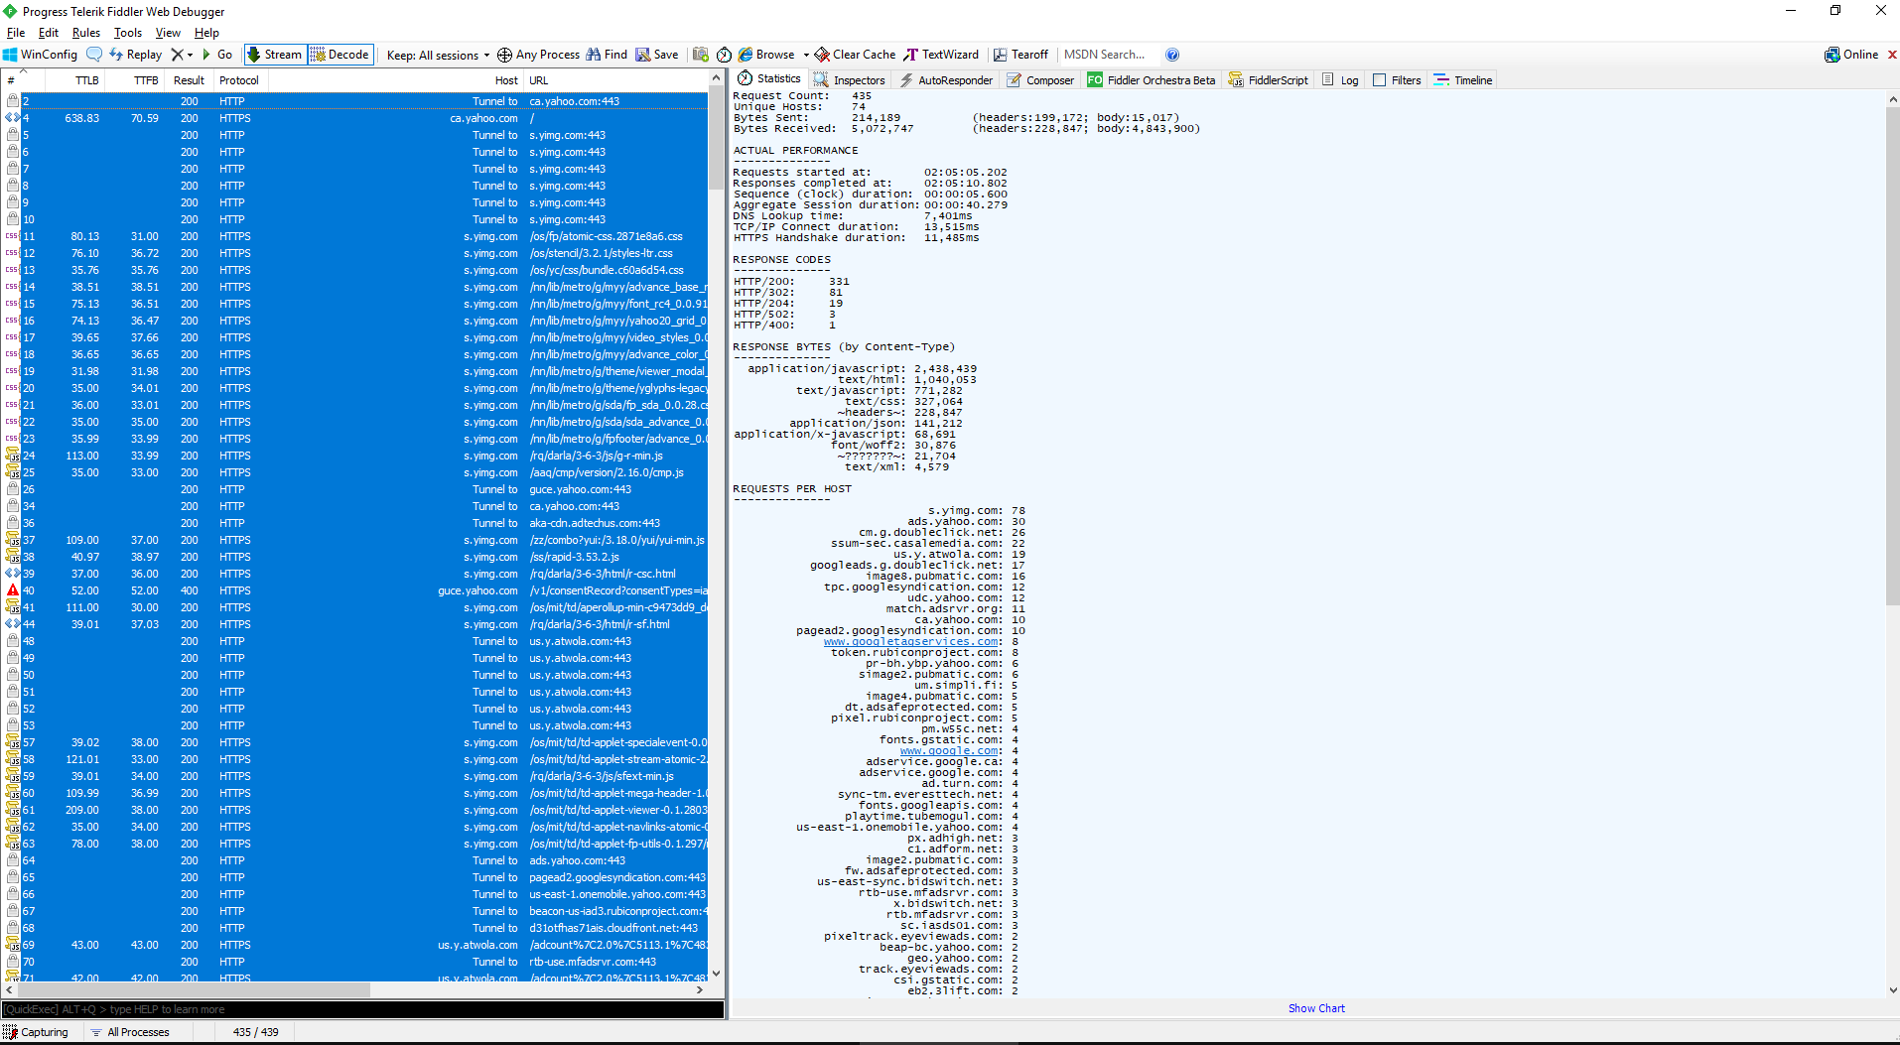
4) Statistics
z

Slide 54
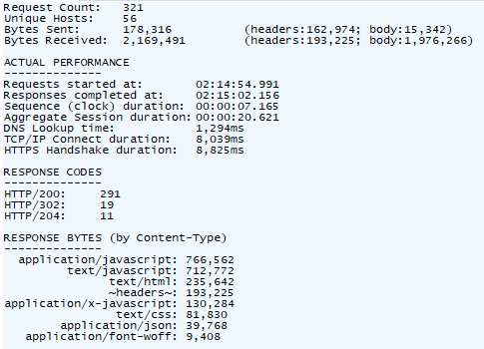
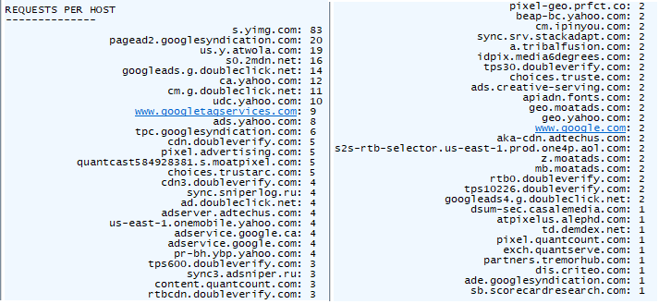
Fiddler Statistics
The statistics gathered here allow a deep understanding of the website.
321 Requests for the (uncached) home page
2.1 Megabytes total size
1.5 MB of Javascript
0.2 MB of HTML
0.08 MB of CSS
0.19 MB of header information
7 seconds to load.
A large amount of TCP/IP and SSL Handshakes

Slide 55
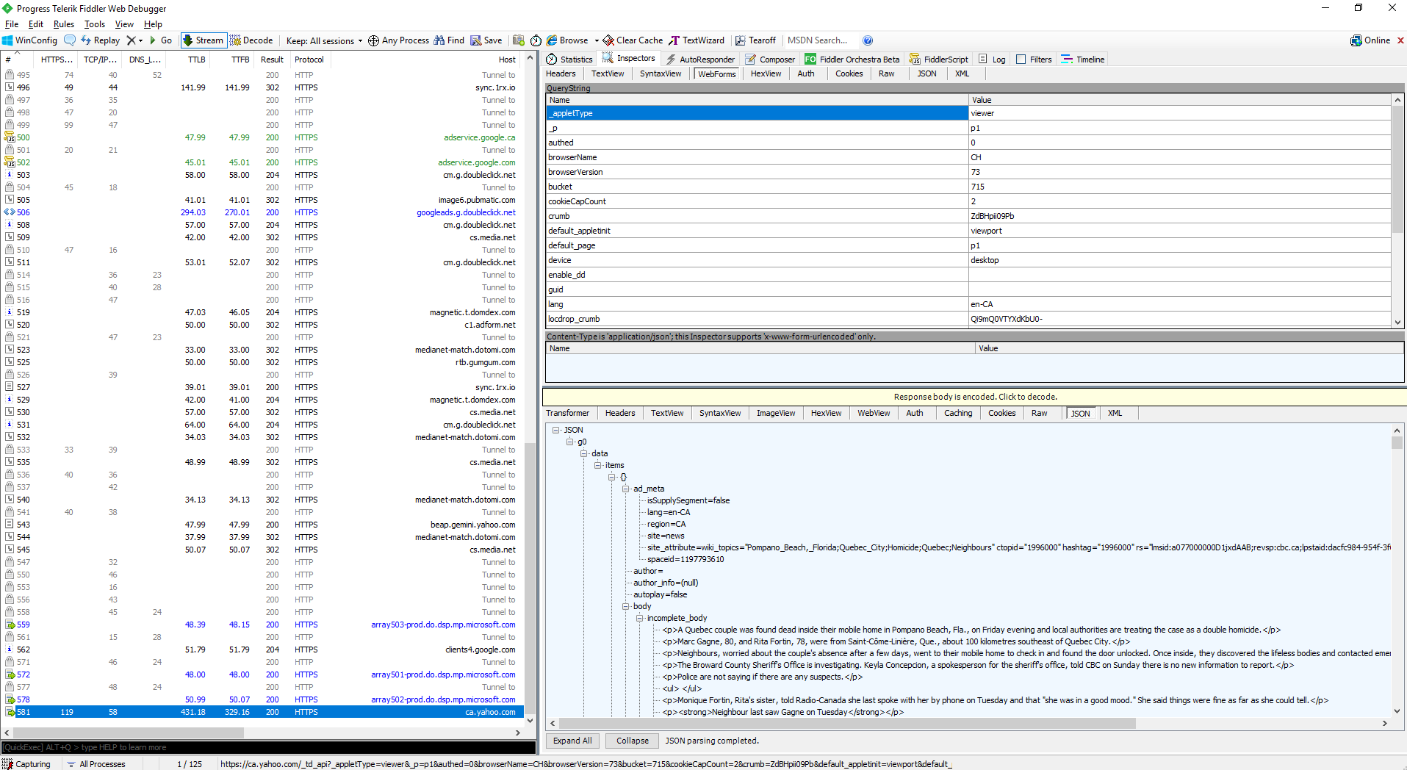
5) Inspector
z

Slide 56
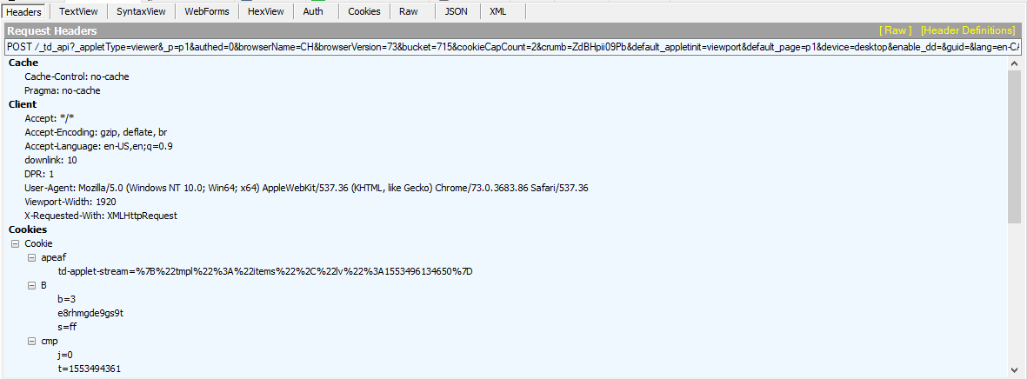
Fiddler Headers
z
You can see the Request Headers here.

Slide 57
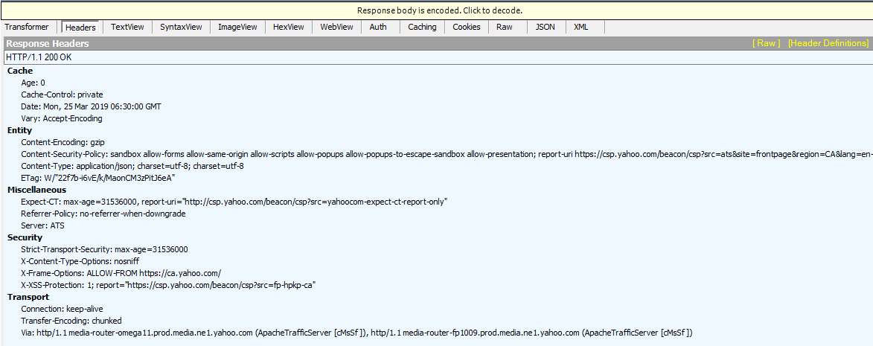
Fiddler Headers
z
You can see the Response Headers here.

Slide 58
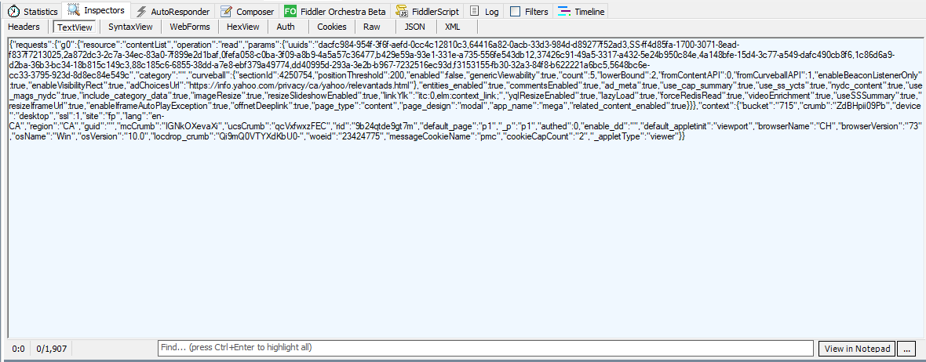
Fiddler TextView
z
You can see the Client Text View here.

Slide 59
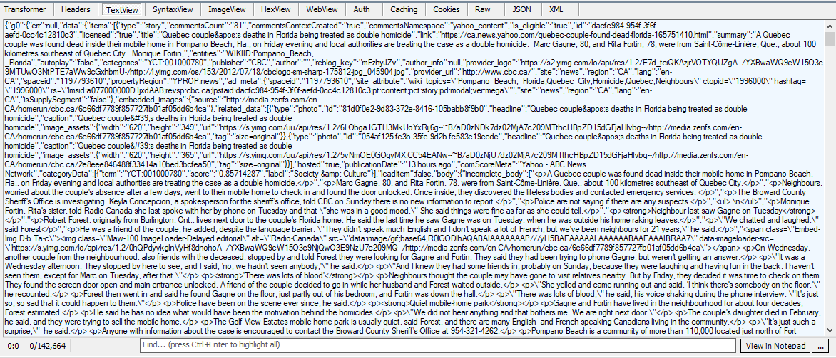
Fiddler TextView
z
You can see the Server Text View here.

Slide 60
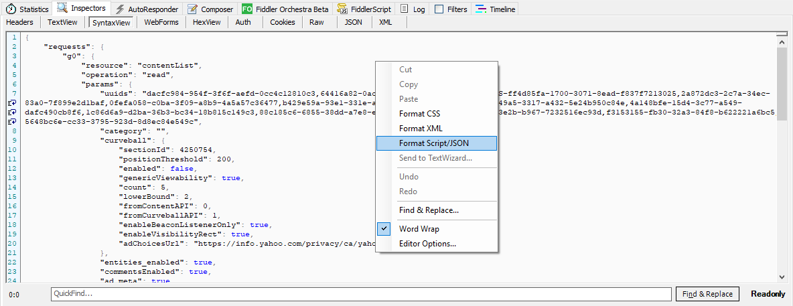
Fiddler Syntax View
z
This allows you to see what the syntax would look like, you can also right click and format into CSS/XML, or Script/JSON.

Slide 61
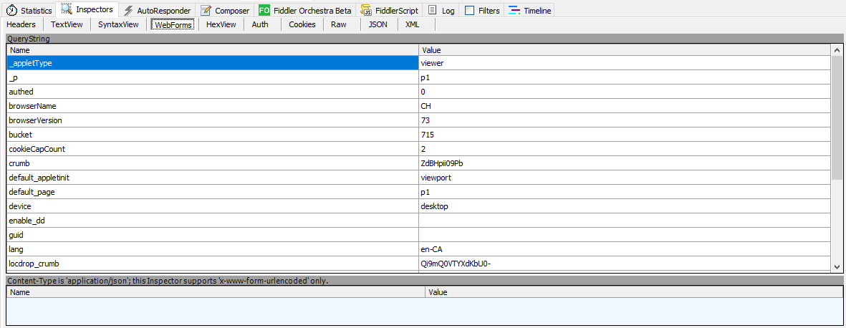
Fiddler WebForms
z
You can see the individual parameters passed to the request in a GUI.
If you right click on the Request, you can Unlock it for Editing, which lets you change the values here.
You can then either drag the request to the “AutoResponder” or the “Composer” to manually send.

Slide 62
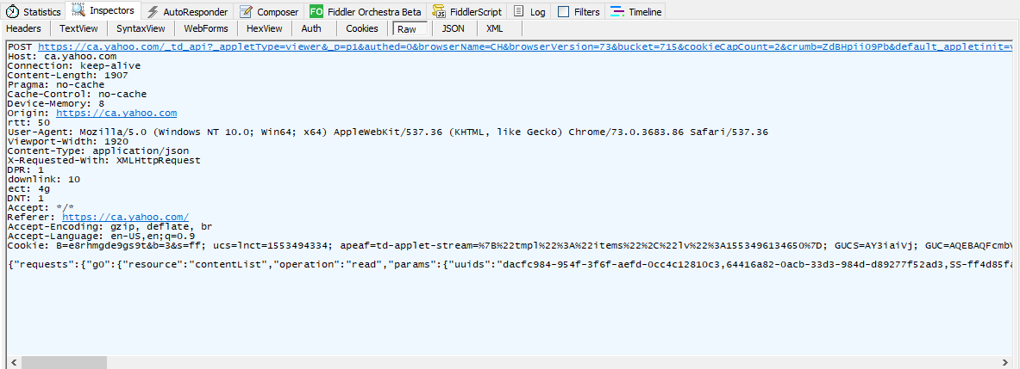
Fiddler RAW
z
Raw let’s you see the request without any processing

Slide 63
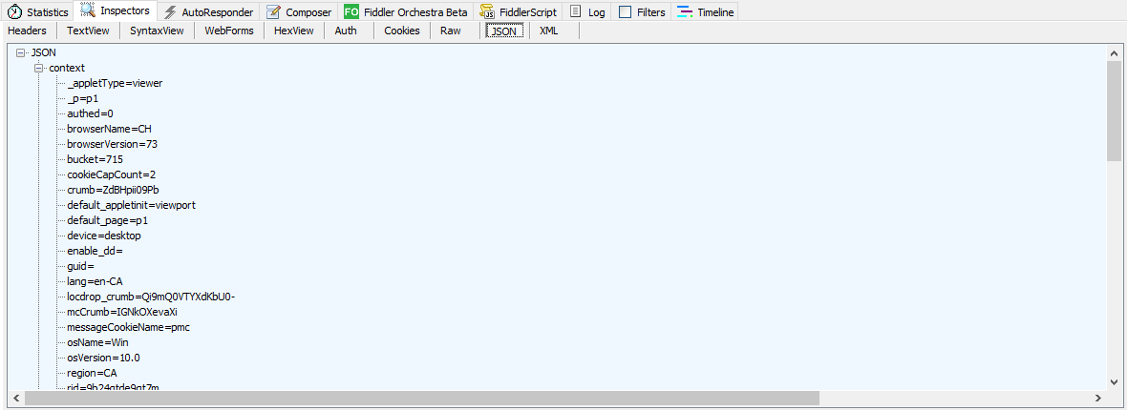
Fiddler JSON
z
JSON shows a formatted version of the request, if the data is in fact JSON.

Slide 64
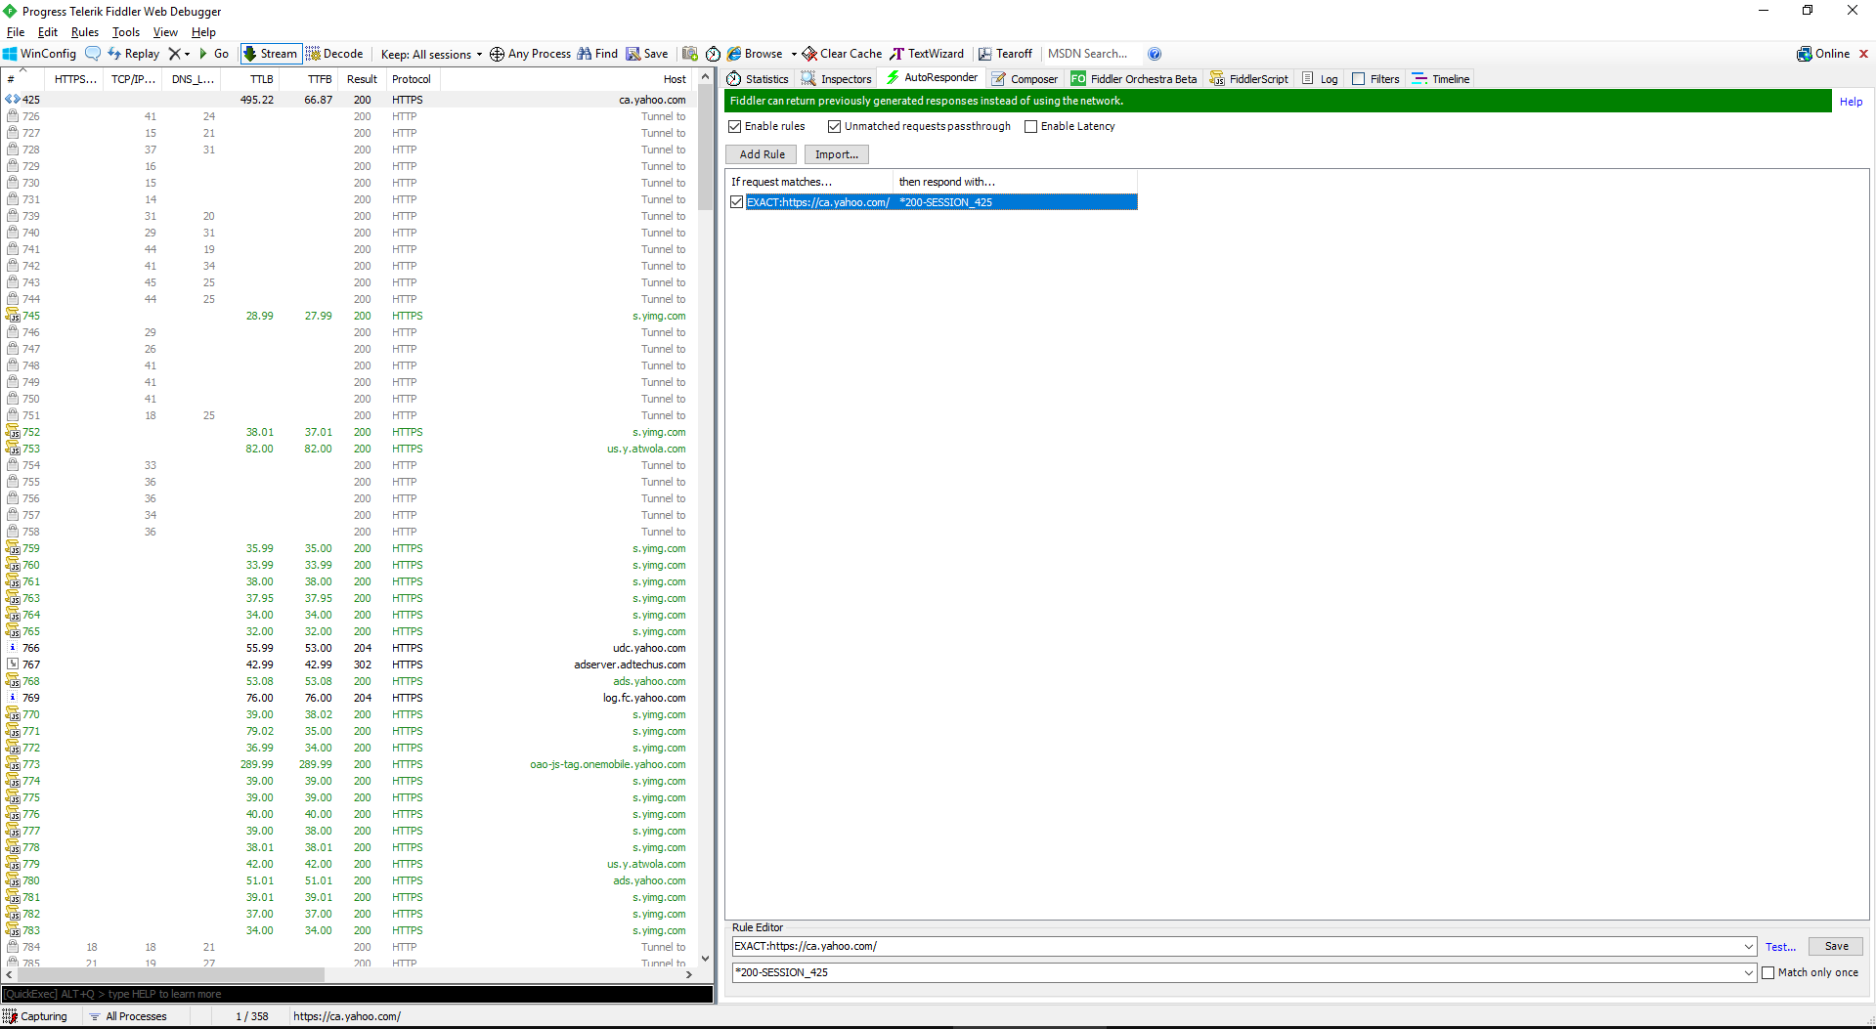
6) AutoResponder
z

Slide 65
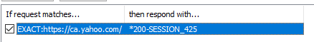
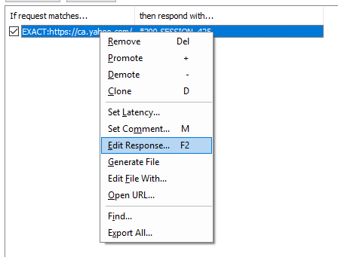

Fiddler Headers
The Auto Responder allows you to drag and session from the left, and make it automatically respond.
You can edit these requests and have them send custom information.

Slide 66

7) Composer
z

Slide 67

Fiddler Composer
z
The Parsed Tab allows you to execute a request again, just drag and drop one onto the tab.

Slide 68

Fiddler Composer
z
The Raw Tab creates a request out of a standard HTTP Request that you can craft yourself or copy/paste from another application.

Slide 69

Fiddler Composer
The Scratch Pad tab allows you to execute a selection of Requests.
This is handy for working with multiple requests at once.

Slide 70

Fiddler Composer
The Options tab enables and disables some features.
Fix Content-Length header is great because it automatically calculates the content length if you’ve modified anything.

Slide 71
8) Timeline
z

Slide 72

Fiddler Timeline
z
A standard waterfall view of the requests.

Slide 73
9) Reissue Requests
z

Slide 74

Fiddler Reissue Requests
You can Reissue a Request by right clicking on it, selecting Replay, and then “Reissue Requests”
If you hold the shift key, it will ask how many concurrent requests you would like to execute.

Slide 75
10) Reissue Requests Sequentially
z

Slide 76

Fiddler Reissue Requests Sequentially
You can Reissue a Request One after Eachother by right clicking on it, selecting Replay, and then “Reissue Sequentially ”
If you hold the shift key, it will ask how many sequential requests you would like to execute.

Slide 77
11) TextWizard
z

Slide 78

Fiddler TextWizard
The TextWizard allows you to transform text in a few different ways.

Slide 79

Fiddler TextWizard
We can turn this YQL query that is URLEncoded and near impossible to read (Top), into a URLDecoded value that is legible (bottom)
Other formats listed here are supported as well.

Slide 80
12) Honorable Mentions
z

Slide 81

Fiddler Rules Menu
“Remove All Encodings”
Remove any Encodings (GZIP, etc) to the client.
“Apply GZIP encodings”
Send GZIP to the client receiving the data.

Slide 82

Fiddler Rules > Performance > Disable Caching
Simulate Modem Speeds
Things go slower.
Disable All Caching

